Slide 1
PSP Project for Indian Embassies and Consulates
Quick Guide – Passport Dispatch Processing

Slide 2
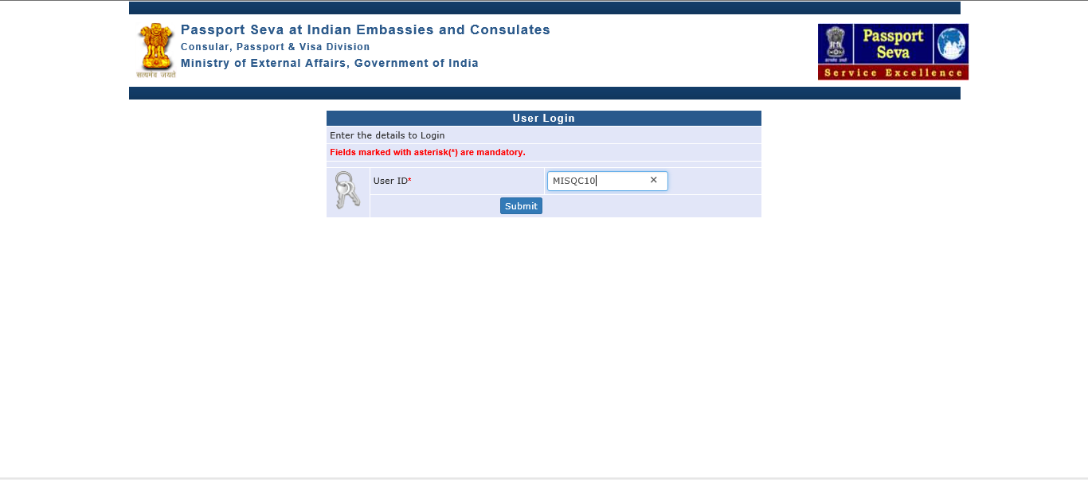
User Login
Visit PSP Office Portal (https://embassy.passportindia.gov.in)
Enter User ID
Press Submit button

Slide 3
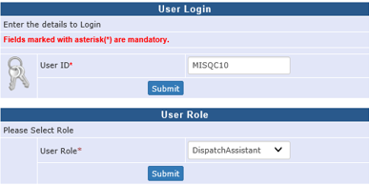
User Login (continued..)
Choose User Role as ‘DispatchAssistant’
Press Submit button displayed below User Role

Slide 4
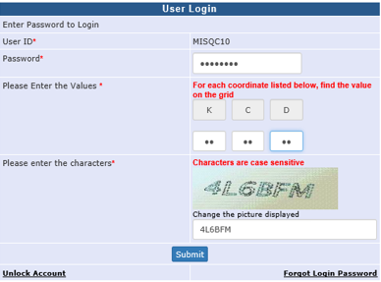
User Login (continued..)
Enter the Password
Check your User Grid and enter the values for the three alphabets displayed on the screen
Enter the characters displayed in the CAPTCHA image
Press Submit button

Slide 5
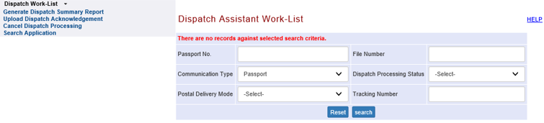
Dispatch Work-List screen (only for International Post/Courier)
Click on the link Dispatch Work-list
Enter valid Search criteria
Press “Search” Button

Slide 6
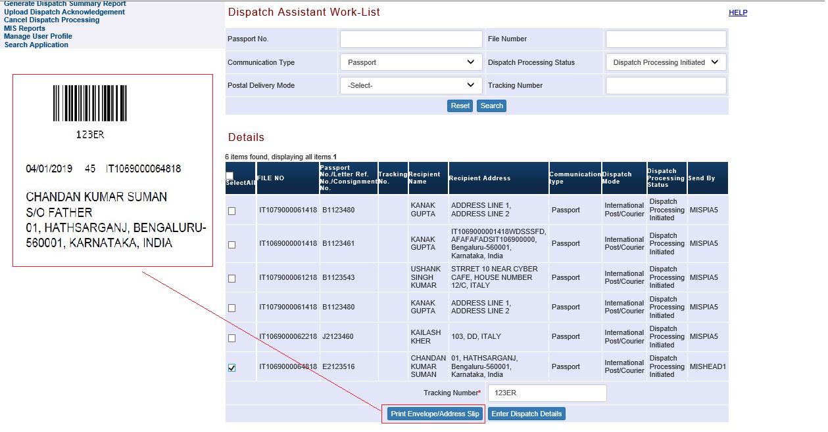
Dispatch Work-List screen (Continued..)
Select record for passport to be dispatched by ticking the checkbox displayed under the leftmost column.
Enter Tracking Number
Print the system generated Envelope/Address Slip by clicking the Print Envelope/Address Slip button (as shown in highlighted box)
Press “Enter Dispatch Details” button

Slide 7
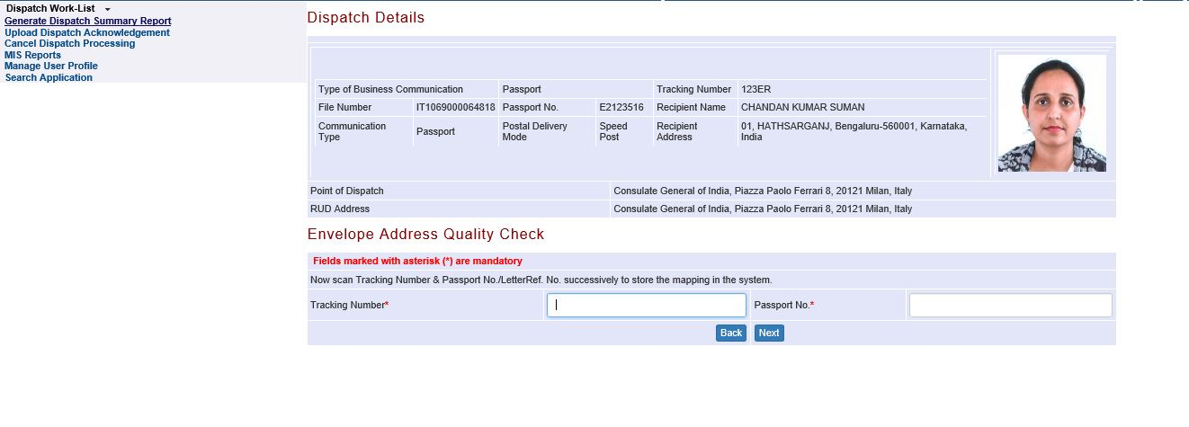
Dispatch Work-List (Continued..)
Enter Tracking Number (i.e. the unique Reference Number provided by Courier Agency for the corresponding passport for the purpose of dispatch to the applicant) and re-confirm the passport number being dispatched under this Tracking Number
Press Next button

Slide 8
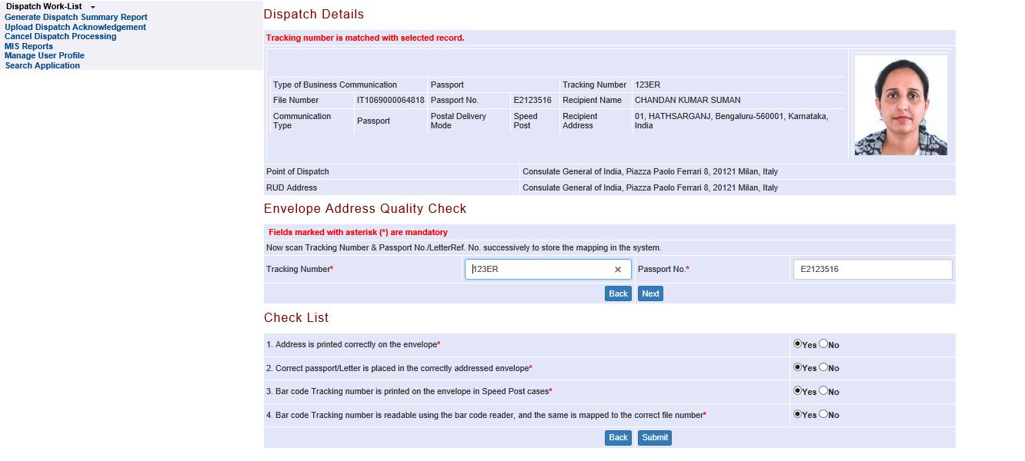
Dispatch Work-List (Continued..)
Execute Dispatch Check List by selecting Yes/No (to re-confirm the tracking number and also to confirm receipt of necessary dispatch acknowledgement physically from the respective courier agency)
Press Submit button

Slide 9
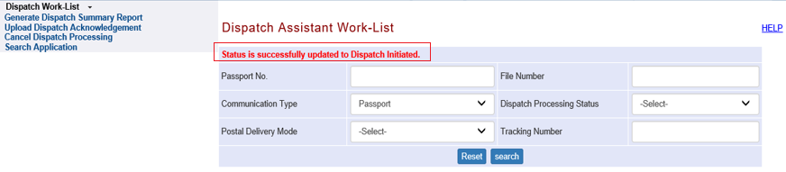
Dispatch Work-List (Continued..)
System displays successful completion of dispatch initiation
Note: Dispatch will be deemed complete only after proof of physical dispatch (Acknowledgement received from Courier Agency/OSP personnel) is uploaded in the system against the stated Tracking Number in the ‘Upload Dispatch Acknowledgement’ screen

Slide 10
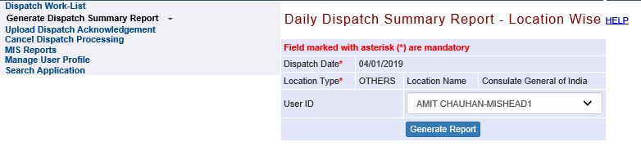
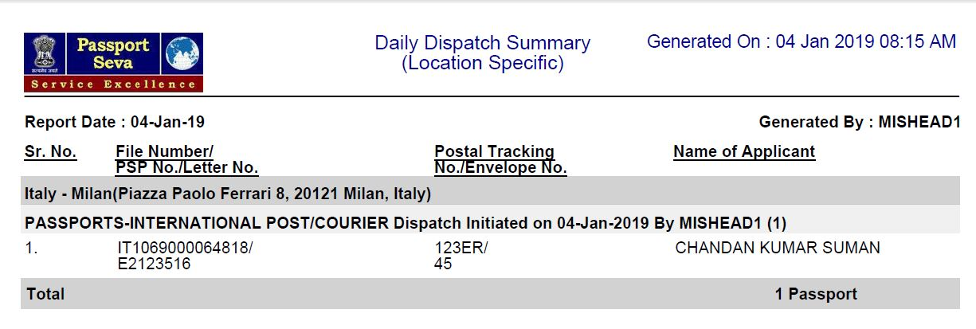
Generate Dispatch Summary Report
Select the appropriate User Id who moved the passport to ‘Dispatch Initiated’ (i.e. ready for dispatch) status
Press Generate Report button to generate/print the (PDF) report of passports ready for dispatch
Notes:
Is point 1 optional or mandatory?

Slide 11
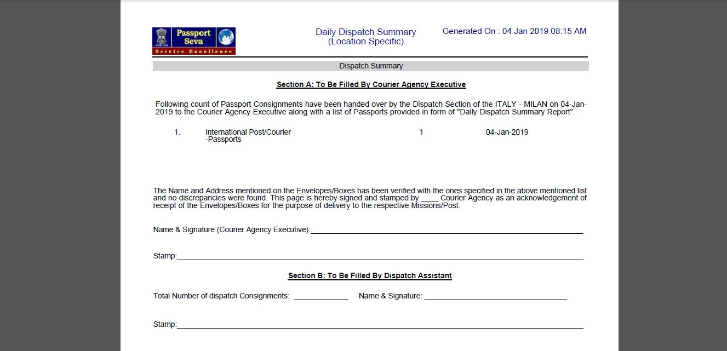
Generate Dispatch Summary Report (continued…)
Take a print-out and get the Dispatch Acknowledgement Receipt page physically signed by the Courier/OSP personnel taking over the passports for actual dispatch purpose. (The same needs to be scanned and uploaded in the system (through Upload Dispatch Acknowledgement screen) to complete dispatch)
One copy of the DSR may be given to the Courier/OSP person as their acknowledgement (optional)
Notes:
Upload DSR Acknowledgment Receipt Page

Slide 12
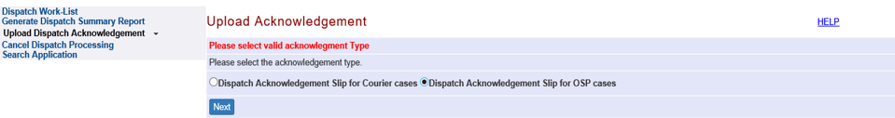
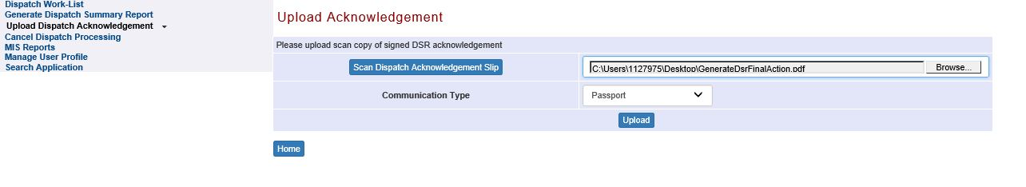
Upload Dispatch Acknowledgement screen
Click on Upload Dispatch Acknowledgement link
Select Acknowledgement Type (choose whether dispatch was done through Courier Agency or OSP) and Press Next button
Press Browse button to search the electronic scan (PDF file) of Dispatch Acknowledgement Receipt
Select Communication Type as Passport
Press Update button to complete the dispatch processing (i.e. to mark the corresponding passports’ dispatch status as ‘Dispatched’ in the system)

Slide 13
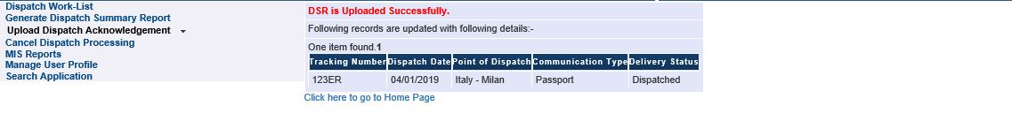
Upload Dispatch Acknowledgement screen (Continued..)

Slide 14
Cancelling Dispatch Processing
(if required)

Slide 15
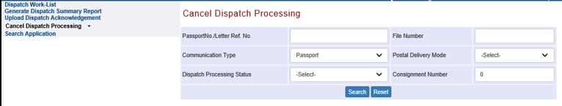
Cancel Dispatch Processing
Click on the link Cancel Dispatch Processing
Enter valid Search criteria
Press “Search” Button
Note : The files which are pending in the dispatch section and additional stop is already imposed by PIA (Stop/Resume Passport Processing link) will only be displayed under the cancel dispatch work-list.

Slide 16
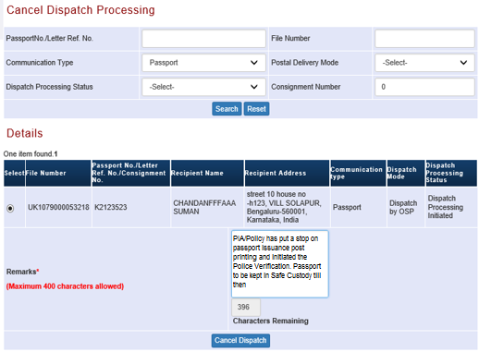

Cancel Dispatch Processing (Continued..)
Select record for Dispatch to be cancelled by ticking the radio button displayed under the leftmost column, and enter due Remarks explaining the reason for cancelling the dispatch
Press “Cancel Dispatch” button to cancel the dispatch and move the Passport for Safe Custody

Slide 17
In case of additional information or clarification, please contact Global PSP Support Team at
Email : global.psp@tcs.com
Phone : +91-0120-672-9595/96
Mobile : +91-730-351-9595
Thank You

